Slide 1
Preprocessing
Data Transformation: Normalization/Scaling/Standardization
Data Cleaning: Incomplete, Noisy, and Inconsistent data

Slide 2
Scaling and Normalization
Why scale or normalize data?
Example:
Marks1 Marks2 Marks3
Student 1 280 70 60
Student 2 200 60 55
Student 3 270 40 30
When you pass this data to a Machine Learning algorithm like kNN, kMeans or Neural Networks, the model would look at Marks1 and see that it is a higher value than Marks2 or Marks3 all around, so model thinks maybe it is of higher importance, which may not be the actual case.

Slide 3
Scaling and Normalization
Why scale or normalize data?
Example:
Marks1 Marks2 Marks3
Student 1 280 70 60
Student 2 200 60 55
Student 3 270 40 30
Euclidean distance (s1,s2) = 80.77
Euclidean Distance (s1,s3) = 43.58
Euclidean Distance (s2,s3) = 71.58
Euclidean distance between Student-1 and Student-2 is being dominated by the marks1.
Same is the case for Euclidean Distance calculation between student-2 and student-3. There also the e. distance is being high because of difference in the marks-1 attribute.
If we see the e. distance for student-1 and student-3, there the distance is not high because marks-1 are close to each each other (viz. 280 and 270). Unlike 200 & 270 or 200 & 280.

Slide 4
Why scale or normalize data?
You have data of a person.
Usecase: Eligibility for a loan
Features:
- age [20-60]
- years of experience [0-40]
- salary [In lacs]
Salary would start dominating in the calculations of ML model if you don’t scale it or normalize it to the same scale of age and Years of experience.
It could be the case that a very young person with medium salary wants to apply for the loan, or a very senior person with medium salary is requesting for loan. Who would be given preference?

Slide 5

MinMax Scaler
Why scale data?
Example:
Marks1 Marks2 Marks3
Student 1 280 70 60
Student 2 200 60 55
Student 3 270 40 30
Euclidean distance(s1,s2) = 80.77
Distance(s1,s3) = 43.58
Distance(s2,s3) = 71.58
Formula for scaling all data into range [0, 1] => [newmin, newmax]
For M1, S1: v’ = ((280 - 200)/(280 - 200))(1-0) + 0 = 1

Slide 6
MinMax Scaler
Why scale data?
Example:
Marks1 Marks2 Marks3
Student 1 280 (1) 70 (1) 60 (1)
Student 2 200 (0) 60 (0.66) 55 (0.83)
Student 3 270 (0.875) 40 (0) 30 (0)
Euclidean distance (s1,s2) = 80.77 (1.069)
Euclidean Distance (s1,s3) = 43.58 (1.419)
Euclidean Distance (s2,s3) = 71.58 (1.89)

Slide 7

Normalization
Why normalize data?
Example:
Marks1 mean sd
Subject 1 70 60 15
Subject 2 72 68 6
Does it mean the student has done better in subject 2?
This can be found out using the Z-score normalization.
In z-score normalization (or zero-mean normalization), the values for an attribute, A, are normalized based on the mean and standard deviation of A. A value, v, of A is normalized to v’ by computing:

Slide 8
Z-score Normalization
v’ is:
How many standard deviations away the point (v) is from the mean?

Slide 9
Normalization
Why normalize data?
Example:
Marks1 mean sd
Subject 1 70 60 15
Subject 2 72 68 6
z-score is 0.67 in both cases.
Both the points are 0.67 std deviation away from the mean.

Slide 10
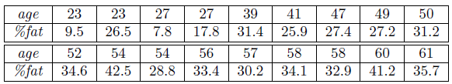
Normalization
Normalize the two variables based on z-score normalization.
In z-score normalization (or zero-mean normalization), the values for an attribute, A, are normalized based on the mean and standard deviation of A. A value, v, of A is normalized to v’ by computing:
Hint:
For age:
Std. deviation = 12.84
Mean=46.44
For %fat:
Std. deviation = 8.99
Mean=28.78

Slide 11
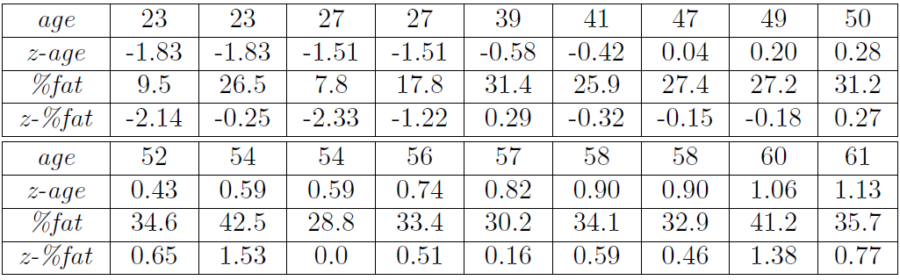
Normalize the two variables based on z-score normalization.
A value, v, of A is normalized to v’ by computing:

Slide 12

MinMax Scaler
Scale using min-max the following group of data:
200, 300, 400, 600, 1000
set min = 0 and max = 1
Min-max normalization maps a value, v, of A to v’ in the range [new_min_{A}, new_max_{A}] by computing

Slide 13

Normalization
Normalize using z-score the following group of data:
200, 300, 400, 600, 1000
The variance of N observations is:
Square root of the variance is called standard deviation.

Slide 14

Normalization
Normalize using z-score the following group of data:
200, 300, 400, 600, 1000
Aside: How many modes are there?
“Mode” is the value that is occurring most number of times.

Slide 15
Thank You!

